Slide 1
Project:
Microfinance Loan Defaulter Prediction

Slide 2
Outline
Introduction
Project problem statement
Approach Used to solve this problem.
EDA
Multi Variate analysis using VIF, CORR and Heatmap
Best Model and Result
Conclusions

Slide 3
Introduction
A Microfinance Institution (MFI) is an organization that offers financial services to low income populations.
Today, microfinance is widely accepted as a poverty-reduction tool, representing $70 billion in outstanding loans and a global outreach of 200 million clients.

Slide 4
Problem Statement
The sample data is provide. In order to improve the selection of customers for the credit, we need to make some predictions that could help in further investment and improvement in selection of customers.

Slide 5
Approach or Process Involved in Analysis
Exploratory data analysis
Feature Engineering
Relation between different features/amenities of house and target column i.e. sales price.
Correlation and identification of multicollinearity problem.
Identifying and Selecting best features that affect sales price.
Data pre-processing.
Model Initialization and evaluation.
Model Validation
Model Testing and Pipelining.

Slide 6
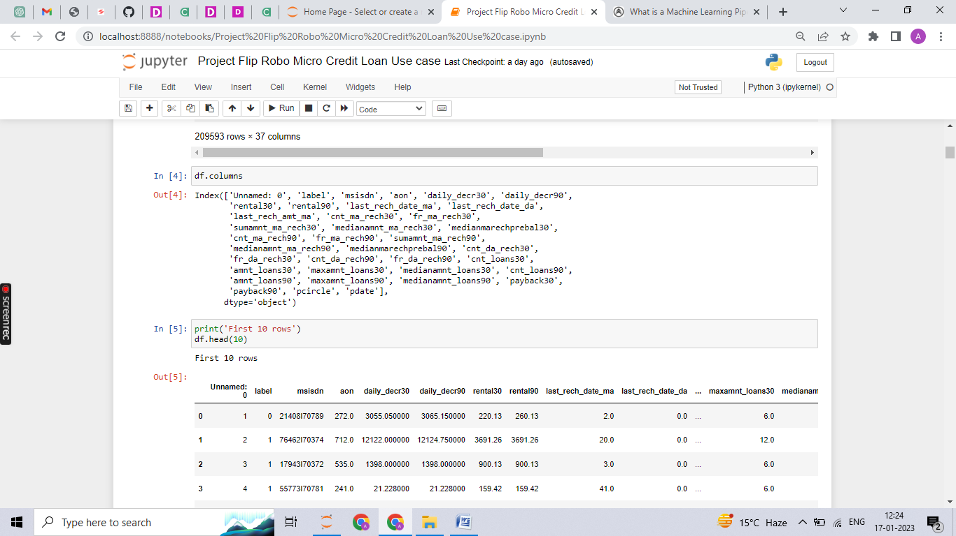
Details of dataset
Row and columns in dataset: 209593 rows × 37 columns
Column names:

Slide 7
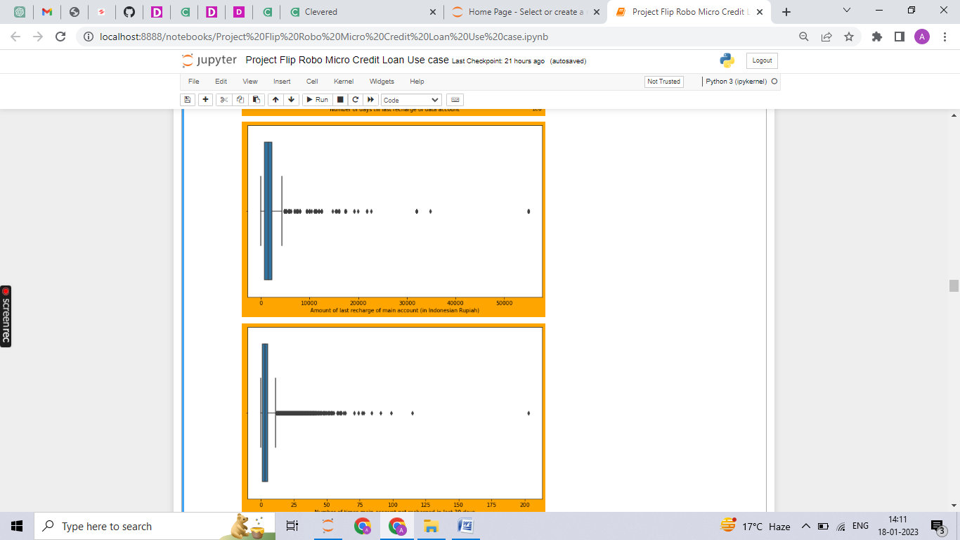
Univariate analysis
Presence of Outliers in dataset

Slide 8
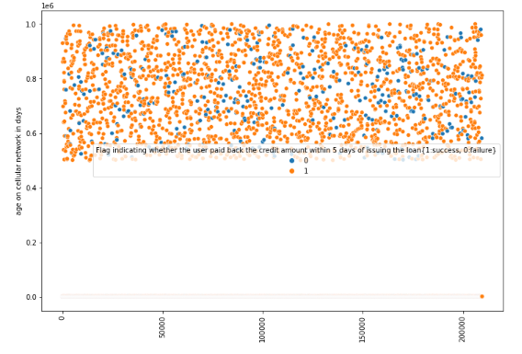
Bivariate analysis
Bivariate analysis using scatterplot

Slide 9
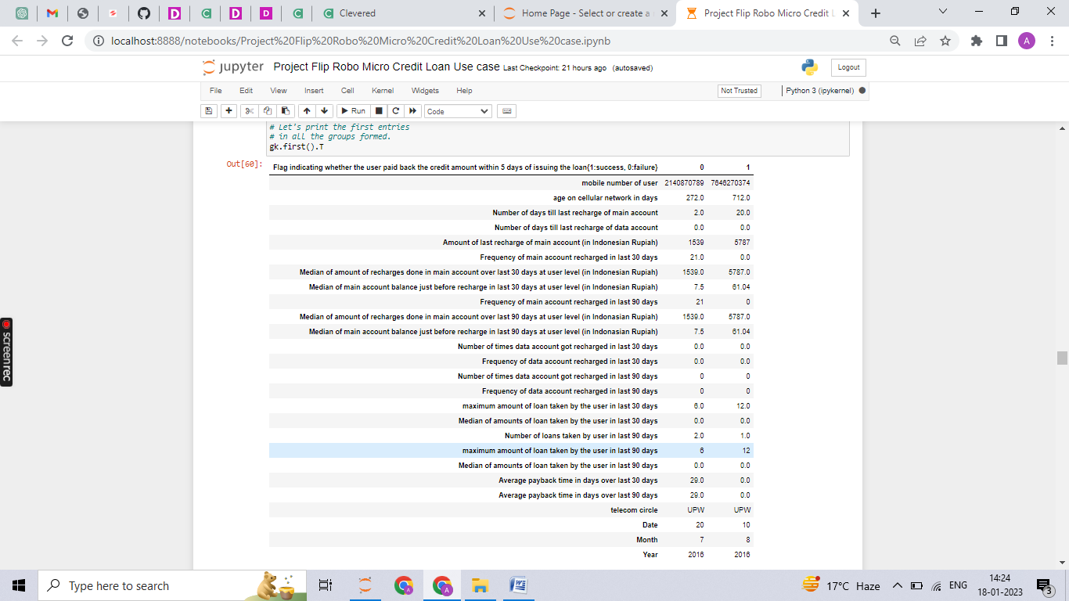
Grouping data by mean on Label

Slide 10
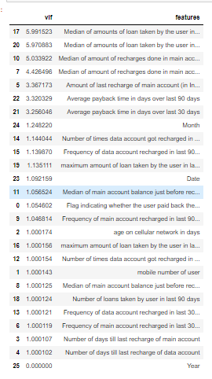
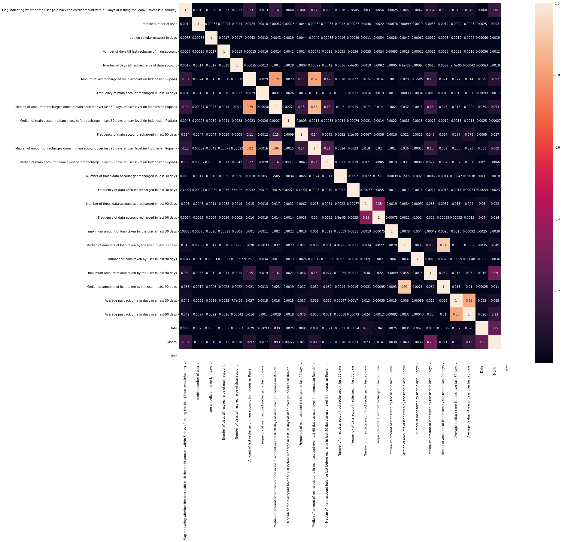
VIF and Heatmap

Slide 11
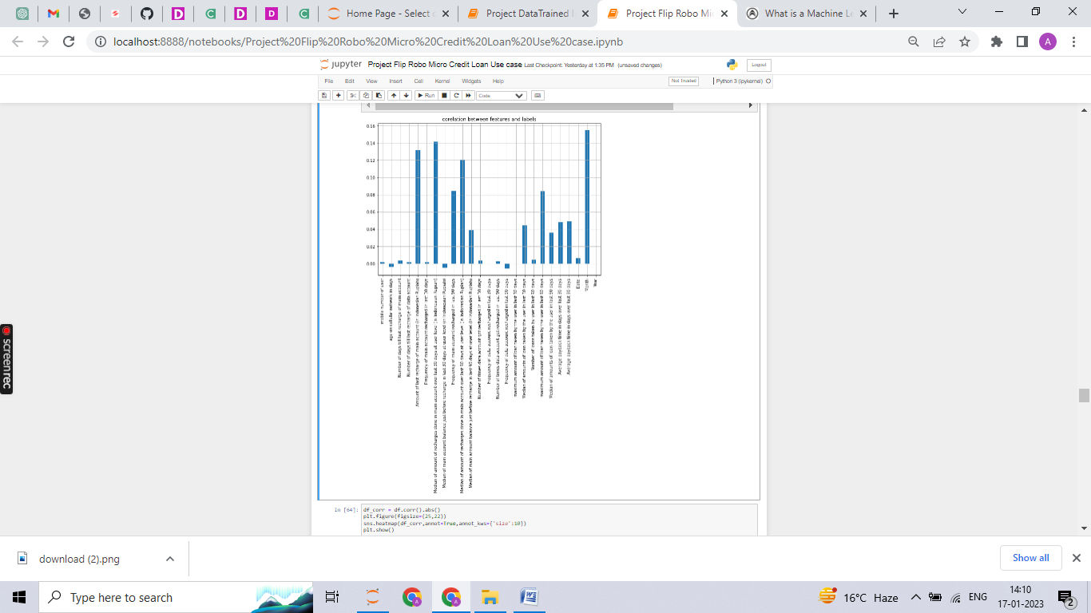
Analysing multicolinearity using Correlation
Features positively related to label are indicated in graph:

Slide 12
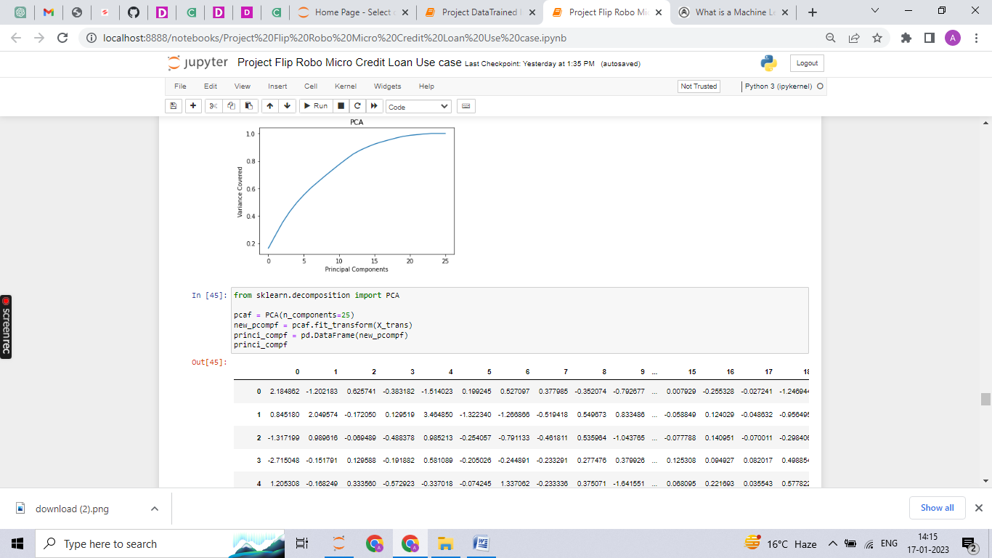
Finding Principal components

Slide 13
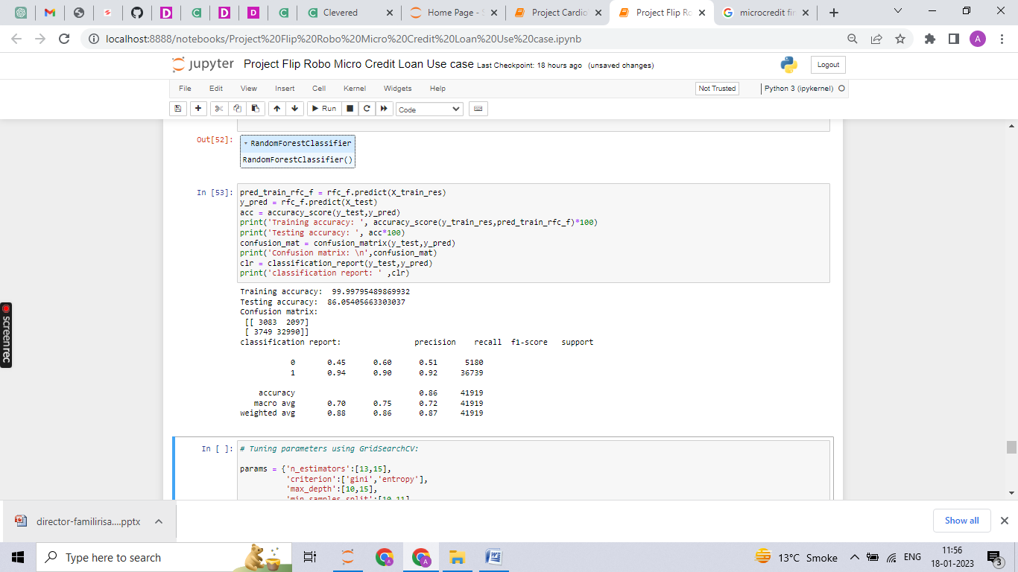
Best Model and Result

Slide 14
Conclusion
The best result is obtained by random forest classifier which is an ensemble technique and XG Boost classifier which is a boosting technique.

